Slide 1
Honours Macroeconomics
Business Cycle Theory Topic 2:
Nominal Rigidity
and
A model with imperfect competition and price setting

Slide 2
Plan
Broad discussion of the need for Nominal Rigidity in models and empirical evidence of sticky prices and their impact
Develop a simple models where firms have pricing power
We will not yet add sticky prices
It will take quite a bit of work to get the base model of firms that set prices, even in a perfectly flexible price world
Next week, we will imbed that model into the RBC model, add sticky prices and derive our final New Keynesian Dynamic Stochastic General Equilibrium model

Slide 3
Introduction
For monetary policy, fiscal policy in nominal variables or nominal shocks to have real aggregate effects in a simple model, the assumed price adjustment must be imperfect in some way
Consider an increase in the money supply
Consumers have more cash so their nominal wealth will increase, but nothing has changed to the sources of their real demand.
If all prices are fixed, equilibrium requires that real output increases to meet the increased demand
If all prices are perfectly flexible all firms (which are perfectly informed) will internalize the “new base” immediately, prices will all increase proportionally to the increase in the money supply, and the real side of the economy will remain unchanged
The more sluggish price adjustments are, the longer the output would be above equilibrium
Naturally, this is in the simple models we use in macroeconomics
Recall, that we need this simplifications for the models to be solved
We use general equilibrium as a solution concept, that requires that all agents optimize
In a model where firms are perfectly informed, they optimize by internalizing any monetary change immediately
Thus, for there to be real effects, there must be some imperfection/friction. Information frictions are far more reasonable, but lead to much more complicated models, so the standard approach is simple, heuristic frictions on the ability of prices to adapt quickly

Slide 4
Introduction
For monetary policy or other nominal shocks to have real effects, price adjustment must be imperfect in some way
Consider a positive fiscal shock
E.g. an increase in (nominal) government consumption demand
If all prices are fixed, equilibrium requires that real output increases to meet the increased demand
If all prices are perfectly flexible, they will increase, which means private consumption demand will fall:
the government demand will crowd out the private consumption and there will be no impact on aggregate demand
The more sluggish price adjustments are, the longer the (temporary) increase in output

Slide 5
Introduction
For monetary policy or other nominal shocks to have real effects, price adjustment must be imperfect in some way
Consider a positive demand shock
A real increase in consumers desire for consumption goods in general equilibrium
If all prices are fixed, equilibrium requires that real output increases to meet the increased demand
If all prices are perfectly flexible and firms have pricing power, they would react optimally by increasing all prices to extract some of the surplus as higher profits, muting the effect on aggregate real output
Put differently: the output will always be at long run equilibrium level, which is higher than before the shock
The more sluggish price adjustments are, the longer the output would be above equilibrium

Slide 6
Introduction
For monetary policy or other nominal shocks to have real effects, price adjustment must be imperfect in some way
Thus, regardless of the shock, in a nominal economy, we need frictions in price adjustments for large, long lasting real effects.
Empirical evidence suggests that monetary and fiscal policy actions may have large real effects
How large? Debatable… Depends on the empirical methodology
The other part of the story is that, in this world, there is the possibility that such policies can improve welfare
How/when this can happen is not trivial. We are building the framework necessary to answer the question: “under what model conditions can policy be welfare improving?”
Another way of thinking about this is the “general idea” that “inflation is bad”
This is at the heart of any de facto inflation targeting policy, which describes the policies most modern central banks

Slide 7
Why is inflation bad?
Perhaps a better question is: when is inflation bad?

Slide 8
Intro: reflections on stabilization policy
Monetary policies govern how the fiat money system functions
What is the role of money?
Medium of exchange, unit of account, store of value,
This is an immensely powerful institution, when it functions well
Frees us from barter and the need for “double coincidence of wants”
Allows extensive specialization and gains from trade, which unlocks productivity gains
But it should be clear that there is an upper bound to the productivity boost that this “oiling of the mechanism” can provide
Once an economy has a fully internalized fiat money and payment system and it is functioning smoothly, monetary policy cannot “create more resources”
In this sense “money should be neutral in the long run”

Slide 9
Intro: reflections on stabilization policy
The value that the monetary system adds to an economy is lies in the efficient aggregation of information via relative prices
Given a numeraire, forces of supply and demand and market clearing provides the information necessary for the efficient allocation of resources to the most productive use.
Any distortion to this system due to mistakes, externalities or unanticipated shocks causes welfare losses
This is where the welfare improving role of monetary policy for stabilization comes in:
If there are inefficiencies (e.g. sub-optimally sticky prices, irrationally low/high demand) then it is possible that the correct monetary policy can improve on welfare
This also indicates the welfare cost of inflation:
The price system is too vast for any decision maker to be aware of all prices at the same time
With high (and variable) inflation the information in the price system becomes noisy:
to make efficient decisions, relative prices must be known and be separated from general price changes
Under high inflation, there in a low signal-to-noise in price changes. It is hard to know which part of a price change is due to real forces and which due to inflation, so mistakes are more easily made and output is less efficiently produced

Slide 10
Introduction (continued)
In the next two sessions we consider several issues along these lines:
Are prices sticky in the data?
If prices are sticky, why? What is the fundamental microeconomic reason for it?
Are sticky prices necessarily inefficient?
How can we build a simple model for price dynamics?
What does price stickiness imply about the macroeconomic relationship between inflation, interest rates and the optimality of the level of output?
I.e. can policy improve on market outcomes when prices are sticky?

Slide 11
Are prices sticky?
Uhlig (2012) asks this as one of the important empirical questions that are actually not fully understood
Sales vs Regular prices
“a price change is a price change”?
Bils and Klenow (2004) is the seminal contribution studying unpublished data from the Bureau of Labor Statistics
Uhlig, H., 2012. Economics and reality. Journal of Macroeconomics, 34(1), pp.29-41.
Bils, M. and Klenow, P.J., 2004. Some evidence on the importance of sticky prices. Journal of political economy, 112(5), pp.947-985.

Slide 12


Are prices sticky?
Nakamura and Steinsson (2008) analyzes the raw data on which the US CPI figures are based
Access to this is not easy
Findings:
Frequency of price changes are greatly heterogeneous across firms
Nakamura, E. and Steinsson, J., 2008. Five facts about prices: A re-evaluation of menu cost models. The Quarterly Journal of Economics, 123(4), pp.1415-1464.

Slide 13
Are prices sticky?
Nakamura and Steinsson (2008) analyzes the raw data on which the US CPI figures are based
Frequency of price changes are greatly heterogeneous across firms
Sales changes prices
but are short lived
Prices often return to pre-sale prices, which is arguably evidence of sticky prices

Slide 14
Are prices sticky?
Nakamura and Steinsson (2008) analyzes the raw data on which the US CPI figures are based
Price changes are greatly heterogeneous
Sales are short lived
Augmented with micro models, there is now a “soft consensus” that measured microeconomic price rigidity lead to sluggishness of the aggregate price level to adjust
In the prescribed follow up paper, Nakamura and Steinsson (2013) relate the micro evidence to the macro responsiveness of aggregate prices and the responses of the economy to nominal demand shocks (which include monetary and fiscal policy shocks)
Conclusion: the macro model we are building is too simple to capture many of these important effects
Nakamura, E. and Steinsson, J., 2013. Price rigidity: Microeconomic evidence and macroeconomic implications. Annual Review of Economics, 5(1), pp.133-163.

Slide 15
Why are prices sticky?
For our macro model to provide a reasonable description of true price dynamics, we need to understand the microeconomic mechanisms that lie behind imperfect price adjustments
A first possibility that this price rigidity is optimal in some sense:
Head, Liu, Menzio, and Wright (2012) argue for sticky prices that arise endogenously based on a search-for-matches model, even when firms are always free to set any price
In this situation, monetary policy cannot improve on welfare
For monetary policy to have a positive welfare impact, it must be that price stickiness is costly/sub-optimal
Gorodnichenko and Weber (2016) provide an empirical study, using stock prices and the (confidential) data from which the Producer Price Index in the US is calculated
They show that companies that have “stickier prices” experience larger fluctuations in valuation
The conclusion they reach is that prices are sticky because of constraints.
Hence price stickiness, empirically, is costly (i.e. not optimal)
Head, A., Liu, L.Q., Menzio, G. and Wright, R., 2012. Sticky prices: A new monetarist approach. Journal of the European Economic Association, 10(5), pp.939-973.
Gorodnichenko, Y. and Weber, M., 2016. Are sticky prices costly? Evidence from the stock market. American Economic Review, 106(1), pp.165-99.

Slide 16
Why are prices sticky?
Several mechanisms have been raised to explain costly/sub-optimal reasons for price stickiness:
Menu Costs
to change restaurant prices, new menus have to be printed
If increase in profits does not cover this cost, it will not be done
Does not seem realistic (in the way it was set up)
Real Rigidities
Efficiency wages – pay above market clearing
To attract the best – Adverse Selection
To motivate behaviour (make shirking risky) – Moral Hazard
“Customer Anger” – Rotemberg (2005) –
Customers respond only to “unfair” prices
Imperfect Information – Lucas (1972) Phelps, Alchian and Holt (1970)
Lucas Jr, R.E., 1972. Expectations and the Neutrality of Money. Journal of economic theory, 4(2), pp.103-124.
Phelps, E.S., Alchian, A.A. and Holt, C.C., 1970. Microeconomic foundations of employment and inflation theory. New York: WW Norton.
Rotemberg, J.J., 2005. Customer anger at price increases, changes in the frequency of price adjustment and monetary policy. Journal of monetary economics, 52(4), pp.829-852.

Slide 17
Why are prices sticky?
Imperfect Information – Lucas (1972) Phelps, Alchian and Holt (1970)
Most intuitive story to me
The version in the textbook is very stylised (allows strawman critique)
I will try provide a broad intuitive coverage of why it makes sense
Although we will use an “exogenous” model which is simpler, but captures the flavour of imperfect price adjustments
New stuff from my reading for this lecture:
Any real reason for price stickiness is now classified as “menu cost”
So the literature has settled on the idea that there are real reasons for price stickiness, and this is now universally labelled as “menu costs”
Back to the benchmark: perfect information
The key mechanism is the amount of information it is reasonable to expect agents to have relative to what they need for optimal choices
If information acquisition is costly, it is optimal to have incomplete information

Slide 18
Why are prices sticky?
Consider an industry with a 100 firms, each with the same input and one imperfect substitute output and a perfectly observed money supply
This is a simple world
Intuition: Easy to keep track of a spreadsheet of 99 relative prices and one stock (Money)
If money is observed to increase relative to real output, all prices will move simultaneously, proportionally
If some specific price falls, there will be a simple optimal response by all the other firms.

Slide 19
Why are prices sticky?
Now consider an industry with a 100 firms, each with 100 inputs and 100 outputs and an imperfectly observed money stock
Now there are potentially 1 000 000 sequences of prices to gather, analyse and understand to make truly optimal decisions
Moreover, the relative size of Money to Real Output is uncertain
If only a small set of prices are observed by each firm, this is a complicated inference problem:
Observed price increases may be due to:
Other firms changing their relative prices
Other firms changing their prices based on their belief of inflation
The optimal response to each is different
Hence sometimes price changes will be suboptimal
Mistakes may be costly, so firms “should” only change prices for “sufficiently clear/large” signals
This suggests sticky prices for a rational reason under imperfect information

Slide 20
Why are prices sticky?
If the imperfect information story is true, it also gives the clearest intuition for the welfare costs of inflation
Particularly “high and variable inflation”
Reduces the signal strength of observed price changes
Induces sluggish/imperfect/incomplete adjustment
This, in turn, induces a misallocation of resources due to distorted price signals
So far we were talking about goods prices.
What about asset prices in the view of Quantitative Easing?

Slide 21
Lucas model (Romer section 6.9)
Formalizes the “signal extraction problem” of observing prices
Optimal to respond via output to relative price changes
If a competitor to raises its price due increasing relative costs, the optimal response is not to raise prices to match – gain market share
If a competitor raises prices due to inflation, optimal to match – own prices will be sub-optimally low – lose profit.
Model predicts price stickiness
Important policy implication:
stabilization policy can only improve welfare if the policy-maker has access to information beyond what the market has
In the model, the market is already doing “optimal signal extraction” from publicly available data
What does this imply for the real world?
Only if the policy maker has more information than the market, can it improve on the market outcome with active/discretionary action
If the policy maker does not plausibly have such information, the best thing that can be done is to keep inflation low and predictable – for which rule based policies like inflation targeting is popular

Slide 22
Toward a usable dynamic model of nominal rigidity
Given that prices are sticky, and thus inflation has real costs, how can policy improve on the situation if at all?
Can policy drive the economy back to a better equilibrium?
Key understanding: from a theoretical point view, policy can improve on the aggregate economic outcome if a “recession” is due the inability of prices to adjust quickly enough. I.e. demand adjusts too slowly.
Do you find this argument convincing? If not, how will you go about convincing someone on the other side?
Where does your lecturer stand? Does that influence your opinion?
For us to be able to give a coherent answer, we need a systematic description of how monetary policy can influence the nominal and real parts of the economy.
We need a model where some of these aspects are formalized
We need:
Firms that can set prices
A solvable way of representing the aggregate impact of slowly adjusting prices, where relative prices distortions is what cause real inefficiency/sub-optimality
Thus we need a dynamic model
Uncertainty is key, so must have this as well

Slide 23
Toward a usable dynamic model of nominal rigidity
Today:
A general equilibrium model with consumption and production of a variety of goods where relative prices determine equilibrium properties of the model
Production is done by many (a continuum) monopolistically competitive firms (= pricing power)
A fixed money supply, no information problems
To focus exclusively on “efficient relative prices” as a benchmark, prices are fully flexible
So we abstract from
Capital
Labour market imperfections
So, while the model is in principle dynamic
The absence of capital (which links production resources over time), and
The flexibility of prices
Imply that the effective problem is period-by-period (static)
Next week:
Use this multi firm setup in intertemporal models of sticky prices
embed this into our RBC framework from last week and ask some simple questions about policy

Slide 24
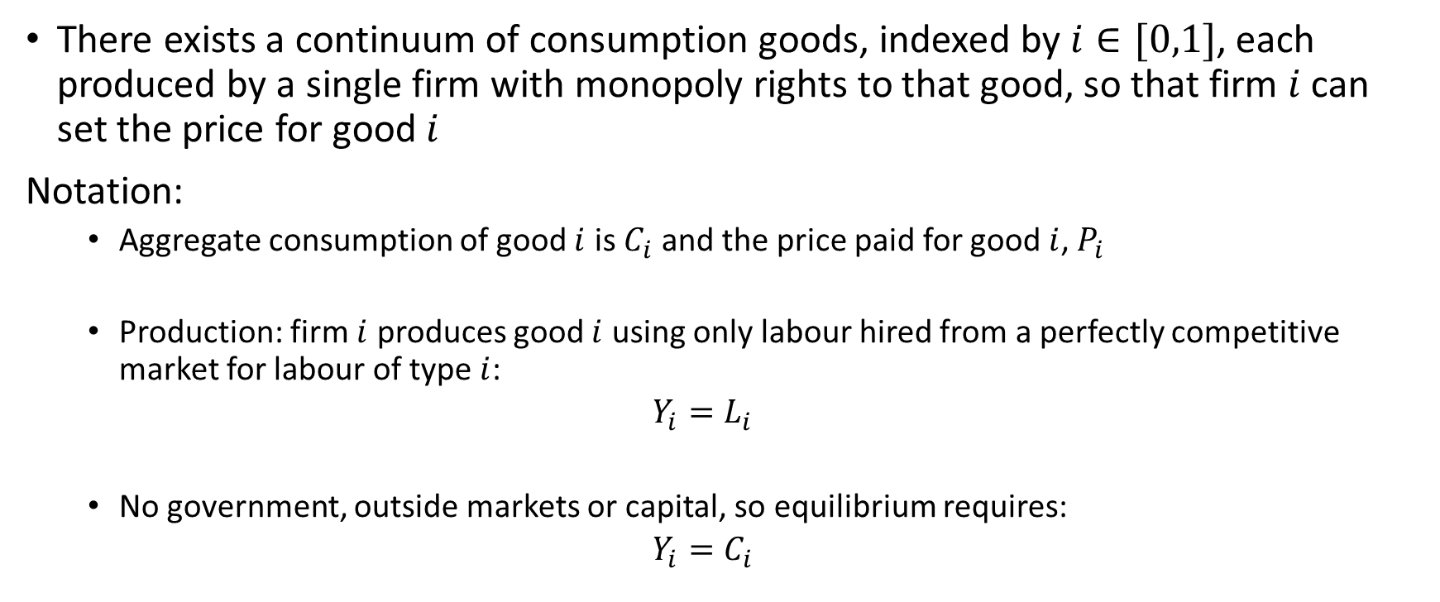
The model: Firms and Production
There exists a continuum of consumption goods, indexed by $i∈[0,1]$, each produced by a single firm with monopoly rights to that good, so that firm $i$ can set the price for good $i$
Notation:
Aggregate consumption of good $i$ is $C_{i}$ and the price paid for good $i$, $P_{i}$
Production: firm $i$ produces good $i$ using only labour hired from a perfectly competitive market for labour of type $i$:
$$Y_{i}=L_{i}$$
No government, outside markets or capital, so equilibrium requires:
$$Y_{i}=C_{i}$$

Slide 25
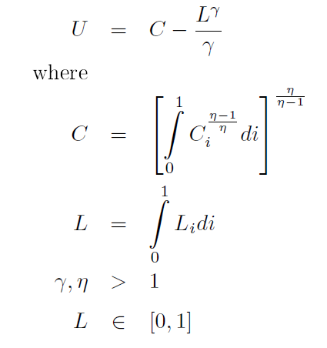
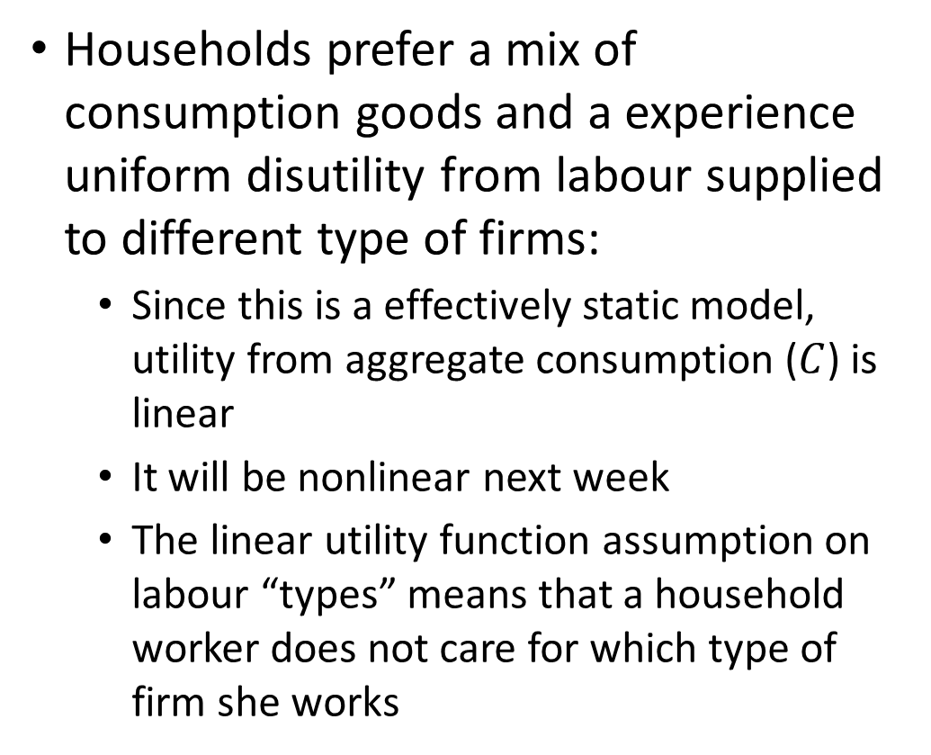
The model: The representative household
Households prefer a mix of consumption goods and a experience uniform disutility from labour supplied to different type of firms:
Since this is a effectively static model, utility from aggregate consumption ($C$) is linear
It will be nonlinear next week
The linear utility function assumption on labour “types” means that a household worker does not care for which type of firm she works

Slide 26
The model: The representative household
Households prefer a mix of consumption goods and a experience uniform disutility from labour supplied to different type of firms:
Since this is a effectively static model, utility from aggregate consumption is linear
It will be nonlinear next week
Extremes?
The linear assumption on labour “types” means that a household worker does not care for which type of firm she works
A concave, constant elasticity of substitution utility function
Consumers prefer average bundles over extreme bundles
If the price of two goods differ, the consumer will consume different quantities of them

Slide 27
The model: The representative household
Budget constraint
Households obtain wealth from labour (WL) and profit shares from ownership of firms (R)
Since “different varieties” of labour are perfect substitutes in consumption and production, the equilibrium relative wage is 1 and we can just consider the aggregate wage and labour supply
Spend it on different varieties of goods
Since the utility function and budget constraint are both linearly separable between consumption and labour, we can consider the two problems independently

Slide 28
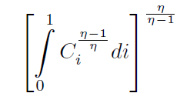
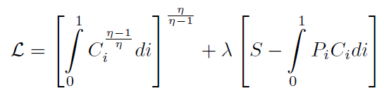
Consumption Demand of variety of goods
Utility function:
Budget Constraint:
Lagrangian:

Slide 29
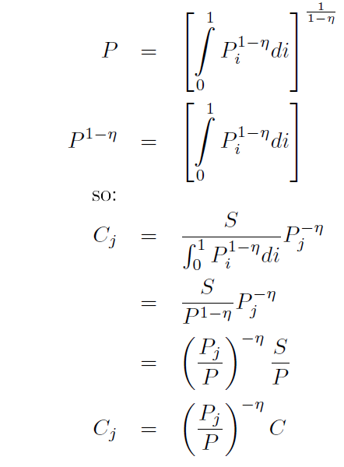
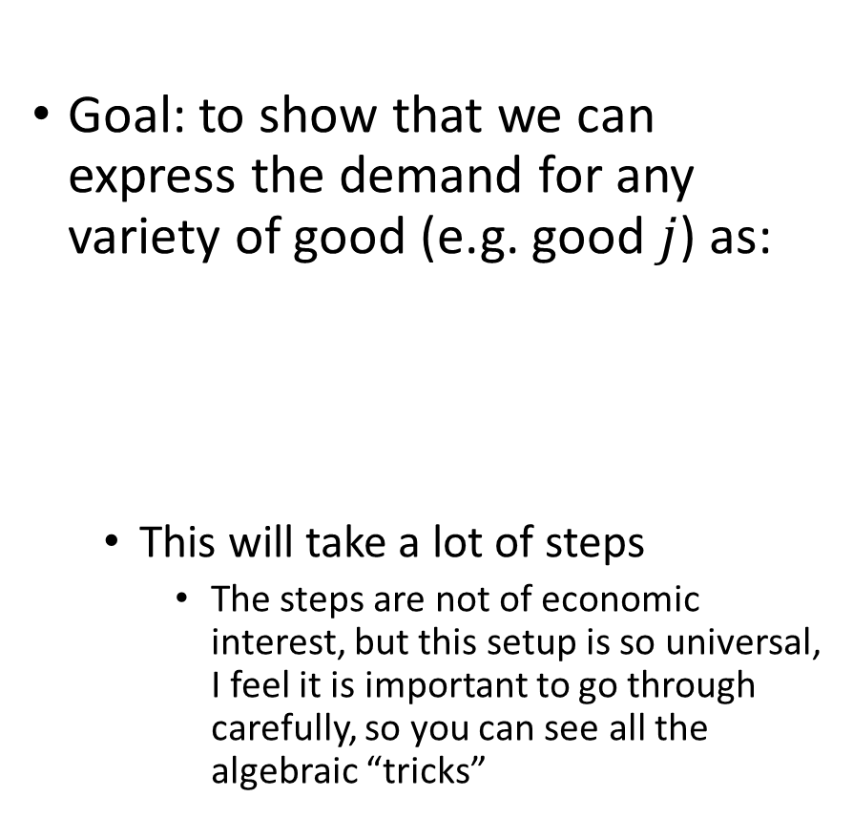
Consumption Demand of variety of goods
Goal: to show that we can express the demand for any variety of good (e.g. good $j$) as:
This will take a lot of steps
The steps are not of economic interest, but this setup is so universal, I feel it is important to go through carefully, so you can see all the algebraic “tricks”
Utility function:
Budget Constraint:
Lagrangian:

Slide 30
Detour
Some calculus intuition on the utility function
When taking derivatives, this function works almost exactly like or

Slide 31
Consumption Demand of variety of goods
First order condition with respect to consumption of good type j:

Slide 32
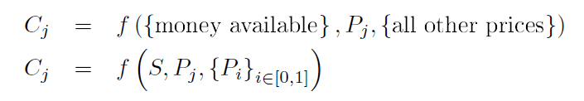
Consumption Demand of variety of goods
As in all economic models, we define a demand function to be of a specific form:
The next steps will yield this result by plugging the FOC for consumption of good j into the budget constraint
The specific functional form we assume leads to a very simple version of this demand function.
And that is the point of this functional form assumption!

Slide 33
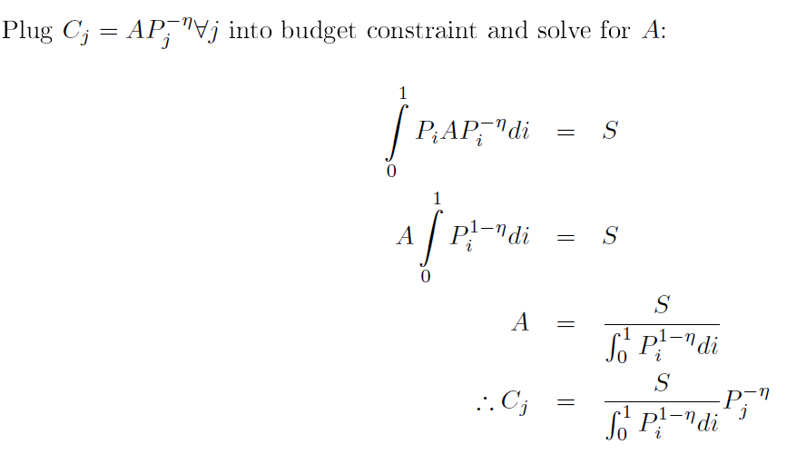
Consumption Demand of variety of goods
Result from above:
Plug in
Budget constraint:

Slide 34
Consumption Demand of variety of goods
Result from above:
Plug in
Budget constraint:

Slide 35
Consumption Demand of variety of goods

Slide 36
Consumption Demand of variety of goods

Slide 37
Consumption Demand of variety of goods
Plug in

Slide 38
Consumption Demand of variety of goods
Plug in
Now, this is already in “demand function form”, but it will be convenient for the rest of the model to go a bit further

Slide 39
Consumption Demand of variety of goods
Result from above:
Plug in
Utility function:

Slide 40
Consumption Demand of variety of goods
Result from above:
Plug in
Utility function:

Slide 41
Consumption Demand of variety of goods

Slide 42
Consumption Demand of variety of goods

Slide 43
Consumption Demand of variety of goods

Slide 44


Consumption Demand of variety of goods
$$C$$
$$C$$

Slide 45
Consumption Demand of variety of goods
$$C$$
$$C$$

Slide 46
Consumption Demand of variety of goods
$$C$$
$$C$$

Slide 47
Consumption Demand of variety of goods
$$C$$
$$C$$

Slide 48
Consumption Demand of variety of goods
$$C$$
$$C$$

Slide 49

Consumption Demand of variety of goods
$$\frac{S}{x}x^{\frac{η}{η−1}}=\frac{S}{x⋅x^{\frac{−η}{η−1}}}=\frac{S}{x^{\frac{η−1}{η−1}+\frac{−η}{η−1}}}$$
$$=\frac{S}{x^{\frac{−1}{η−1}}}$$
$$C$$
$$C$$

Slide 50
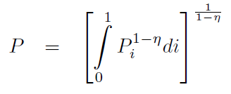
Consumption Demand of variety of goods
Central “trick” in models that use CES/Dixit-Stiglitz aggregators:
We define the appropriate price aggregator as
Thus:
Thus the “CPI” is a nonlinear average of prices in this model
Is this cheating?

Slide 51
Consumption Demand of variety of goods
Finally,
the demand functions:
Results from above:

Slide 52
Consumption Demand of variety of goods
Finally,
the demand functions:
Results from above:

Slide 53
Consumption Demand of variety of goods
Finally,
the demand functions:
Results from above:

Slide 54
Consumption Demand of variety of goods
Finally,
the demand functions:
Results from above:

Slide 55
Consumption Demand of variety of goods
Finally,
the demand functions:
Results from above:

Slide 56
So what?

Slide 57
So what?
The demand function for good j is:
Firm j cares only about what it can sell
We are building a micro-founded macro model
The demand for the good of firm j now depends only on:
Its own price
The aggregate price
The aggregate demand
The microeconomic elasticity of substitution across goods
We will use this to solve the problem of the typical firm

Slide 58
Firm Problem:
Firms are monopolistically competitive profit maximizers with a linear production function subject to a demand function for their variety. Hence we can model their decisions as one of choosing a (relative) price.
Firms care about real profits: real revenues minus real costs
Using
Production functions:
Demand functions:
Equilibrium condition:

Slide 59
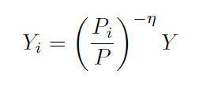
Firm Problem:
Firms are monopolistically competitive profit maximizers with a linear production function subject to a demand function for their variety. Hence we can model their decisions as one of choosing a (relative) price.
Firms care about real profits: real revenues minus real costs
Using
Production functions:
Demand functions:
Equilibrium condition:

Slide 60
Firm Problem:
Plugging in everything into the firm problem yields the new objective function:

Slide 61
Firm Problem:
Plugging in everything into the firm problem yields the new objective function:

Slide 62
Firm Problem:
Plugging in everything into the firm problem yields the new objective function:

Slide 63
Firm Problem:
Plugging in everything into the firm problem yields the new objective function:

Slide 64
Firm Problem:
Plugging in everything into the firm problem yields the new objective function:
Thus firms optimally charge a mark-up over marginal costs, which is a function of the elasticity of demand (eta)

Slide 65
The model: The representative household
Households prefer a mix of consumption goods and a experience uniform disutility from labour supplied to different type of firms:
Since this is a static model, utility from aggregate consumption is linear
It will be nonlinear next week
The linear assumption on labour “types” means that a household worker does not care for which type of firm she works

Slide 66
The model: The representative household
Budget constraint
Households obtain wealth from labour (WL) and profit shares from ownership of firms (R)
Since “different varieties” of labour are perfect substitutes in consumption and production, the equilibrium relative wage is 1 and we can just consider the aggregate wage/labour supply
Spend it on different varieties of goods
Since the utility function and budget constraint are both linearly separable between consumption and labour, we can consider the two problems independently

Slide 67
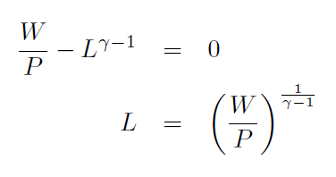
Labour Supply
From above:
Plugging into utility maximization problem:
FOC and rearranging:

Slide 68
Equilibrium:
In equilibrium:
From the labour supply curve:
Recall from the firm problem:

Slide 69
Equilibrium:
In equilibrium:
From the labour supply curve:
All firms face the same elasticity of demand and the same real wage, thus they will charge the same relative price as a function of aggregate output:
Since all firms charge the same price, the aggregate price is equal to the individual price:

Slide 70
Equilibrium:
Hence, we get the result that prices are fully flexible, the equilibrium real output is not a function of aggregate prices/money. I.e. we get the standard monetary neutrality result:
The real wage and equilibrium labour quantity:

Slide 71

Equilibrium:
To close the model, we need to specify what determines aggregate demand.
We make the simplest possible assumption, which is sufficient to get most of the interesting results we need in a dynamic situation: Demand is equal to the real money supply
Thus the equilibrium price is:
And we get the (unsurprising) result that changes to money supply are always absorbed in prices

Slide 72
Equilibrium: Inefficiency due to market power
Due to market power of firms, the equilibrium, even with flexible prices, is inefficient.
To see this, we evaluate what allocation a “benevolent social planner” would choose for this economy
A benevolent social planner has only one problem: maximize the utility of the representative household:
Subject only to the aggregate resource constraint:

Slide 73

Equilibrium: Inefficiency due to market power
Social planner problem:
Because firms have market power, the market equilibrium produces an inefficiently low output, even though the relative allocation of resources is efficient
Most new Keynesian models assume a taxation scheme to fix this inefficiency

Slide 74
Summary and Preview
We now have all of the components of the final model, but without frictions
Next week we will return to a dynamic model where firms cannot set prices freely in every period, and hence we will have real effects of monetary policy

